Slide 1
Welcome to Rory Device Directory!
Utilities as a Service Licensing Application
Please add your devices and automations here. “+” to begin.
[Editable Title Field ex. Space Number, Pedestal, etc.]
[Option to leave blank]
+

Slide 2
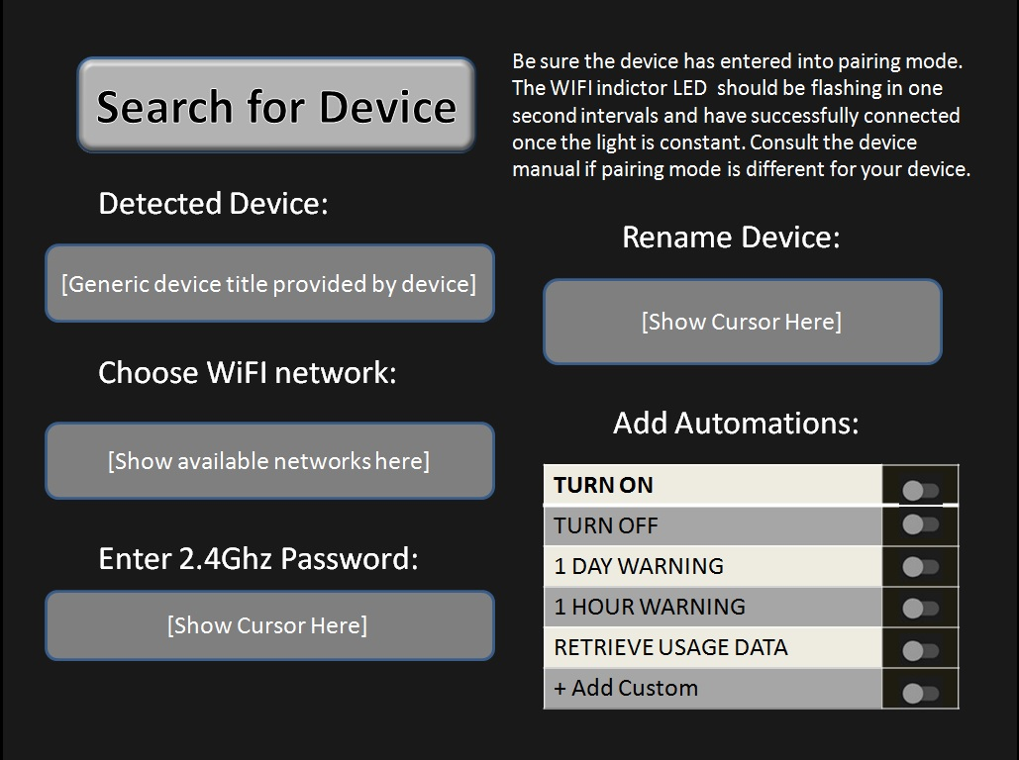
Welcome to Rory Device Directory!
Utilities as a Service Licensing Application
Please add your devices and automations here. “+” to begin.
[Editable Title Field ex. Space Number, Pedestal, etc.
[Option to leave blank
+

Slide 3
Search for Device
Be sure the device has entered into pairing mode. The WIFI indictor LED should be flashing in one second intervals and have successfully connected once the light is constant. Consult the device manual if pairing mode is different for your device.
Detected Device:
[Generic device title provided by device]
Choose WiFI network:
[Show available networks here]
Rename Device:
Enter 2.4Ghz Password:
[Show Cursor Here]
[Show Cursor Here]
Notes:
This should be a pop up over the previous slide, in place of that image.

Slide 4


Rory Device Directory
Utilities as a Service
+
[Editable Title Field ex. Space Number, Pedestal, etc.] | ON/OFF OPTION | 1 DAY WARNING | 1 HOUR WARNING | RETRIEVE USAGE DATA | MANUAL OVERRIDE ALWAYS ON/OFF
[Option to leave blank]
Pedestal 1
Pedestal 2
Pedestal 3
{Toggles determine which webhooks to trigger device need to be generated}
(The 1 day warning and 1 hour warning can either be set up by a webhook setting a timer or countdown on the device and the device notifying when threshold reached, or by creating automation to be sent in x:xx time after purchase, based on selection.)

Slide 5
Rory Services Offered
Edit individually in each field or in top field for bulk
[Editable Title Field ex. Space Number, Pedestal, etc.] | Allow immediate activation | Allow Scheduled activation | Add Buffer Times Between Activations | Time Blocks/ Durations Available | Pricing
[Option to leave blank]
Pedestal 1 | toggle button | “ “
Pedestal 2 | toggle button | “ “
Pedestal 3 | Toggle button | “ “
{Automations that don’t communicate to the device directly}
Notes:
It will be a toggle button in the field, for on or off, but clicking in the field will take to the specific settings page for that “pedestal”.

Slide 6
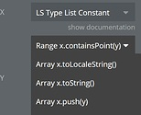
Rory Calendar and Scheduled Activation Options
12 or 24 Hour Selection
(add AM/PM Field)
Time Increments Available
 | 1 Minute
 | 5 Minutes
 | 10 Minutes
 | 15 Minutes
 | 30 Minutes
 | + Custom Amount
12
24
Time Zone:
+ Apply to all
Add Map to Booking Flow
Notes:
This would be accessible from each field in the column, for each “pedestal”. Or in the bulk option, just the one time for all.

Slide 7
Rory Buffer Time Options
Show in Field When Set to None:
[Ex: No, N/A, or Custom Note]
Time Increments Available
 | 15 Minutes
 | 20 Minutes
 | 30 Minutes
 | 1 Hour
 | 2 Hours
 | + Custom Amount
+ Apply to all
Notes:
This would be accessible from each field in the column, for each “pedestal”. Or in the bulk option, just the one time for all.

Slide 8
Rory Time Block Duration Services
 | 1 hour
 | 3 hours
 | 12 hours
 | 24 hours
 | 3 Days
 | 1 Week
 | 2 Weeks
 | 1 Month
 | +
+ Apply to all
Notes:
This would be accessible from each field in the column, for each “pedestal”. Or in the bulk option, just the one time for all.

Slide 9

Rory Services Offered
Edit individually in each field or in top field for bulk
[Editable Title Field ex. Space Number, Pedestal, etc.] | Allow immediate activation | Allow Scheduled activation | Add Buffer Times Between Activations | Time Blocks/ Durations Available | Pricing
[Option to leave blank]
Pedestal 1 | toggle button | “ “ | “” | 1 hour 3 hours 12 hours 24 hours 3 days 1 week 2 weeks 1 month | $20 $30 $40 $45 $120 $150 $200 $400
Pedestal 2 | toggle button | “ “
Pedestal 3 | Toggle button | “ “
1 hour X
3 hours X
12 hours X
24 h ours X
3 days X
1 week X
2 weeks X
1 month X
+
Notes:
I was trying to get the time options to look the way the skills do on freelancer. Bubbles with “X”’s next to them to remove them. And a “+” would always be at the end of the list to bring up a drop down menu that shows any of the selected options that were “x”-ed out of, to add them back. No Plus when none have been x-ed out. The point of all this would be to make it editable from the one page for simplicity, seeing it all at once, not having to load chart for each. Clicking in the field would take you back to the settings chart, tied to that specific field.

Slide 10
Rory Time Block Duration Service Prices
 | 1 hour | Enter amount here
 | 3 hours | “”
 | 12 hours | “”
 | 24 hours
 | 3 Days
 | 1 Week
 | 2 Weeks
 | 1 Month
 | +
+ Apply to all
Notes:
This grid will only show the options on the list that were selected for each title field. In bulk they will only have to enter once. Or push the apply to all on any one of these charts they are on to change it for each option that includes it. They can still click in each field under the pricing column to edit this same chart for each specific “pedestal”, or whatever the title field is called.

Slide 11
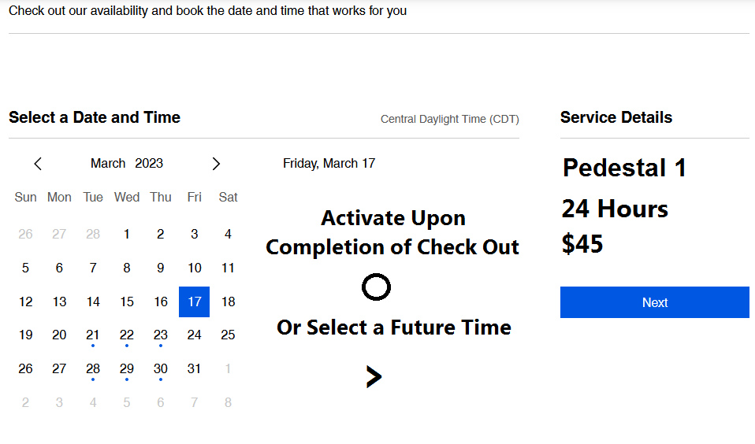


Slide 12

Rory Agreement Options
Upload Agreement
{Show uploaded files here}
 | Convert to text on agreement page.
 | Add field to manually enter agreement text
 | Add option to download file for signature
 | Add option to sign by checking box
 | Add option to upload signed document
 | Add option to enter signature on page
 | Add option to upload photo ID
 | Add additional pages for rules, special messages, etc.
 | Add pop ups for additional messages

Slide 13
Same payment processing options as wix booking app ( I think this might just be payments wix offers you to connect to period) can be added.
At some point, I may want to add option where I would have a merchant account and act as the payment processor possibly. At that point, that might be set as the recommended default. I might look into that more over the course of developing this.
Code it so that an Authorization code for deposits is embedded if user selects. To any payment processor. This would automatically charge the pricing amount and reserve the user entered maximum deposit for the duration of the stay. Reauthorize as needed for duration. Seems like paypal only had the option for 30 days maximum, which a little bit defeats the purpose here.
Easy options for getting the money from deposit if needed- full or partial amounts.
Option to set up recurring monthly and one deposit, for long term.

Slide 14
Rory Payment Authorization Settings
Use Authorization Hold on payment method for deposit
Authorize payment method individually or go to in bulk
 | Pedestal 1 | Pedestal 2 | Pedestal 3 | Pedestal 4 | Pedestal 5
[Option to leave blank]
1 Hour | N/A | “” | “”
3 Hours | N/A
24 Hours | $100
2 Weeks | $100
1 Month | $200 | “” | “”

Slide 15
Is there a way to set it to recognize if you have received an email of a zelle payment for a certain amount, and then trigger the webhook to turn on the device? Can an inbox be set to be scanned for such incoming messages and certain amounts in certain places, to mark it as a payment received?
It is against the terms to use zelle for business, I know, so this won’t be made easy.
Maybe just have a manually approvable booking once the user confirms payment was received, so that the switch is still set to be triggered automatically and turn off based on the timing settings, but the start be manually confirmed.

Slide 16
Thank you page should be similar to wix pages with option to edit and other customizations such as photos, elements, or layout allowed.
Recommended spaces for wifi code, highlighted rules, and special directions and notes.
Thank you email can be customized to be different or have an option to send image of thank you page to email.
I guess I might need to make another of these when the ideas come to me for how it should look, adding the photos to individual spots, the daylight show, and the interactive map set up.

